Slide 1
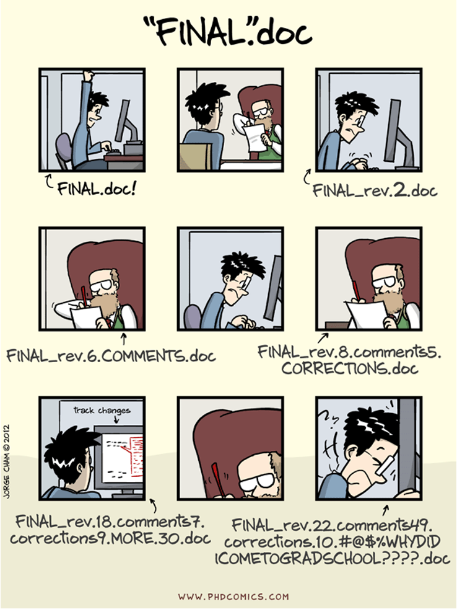
Presentation adapted from github user “javedali99” in a way that is consistent with their license

Slide 2
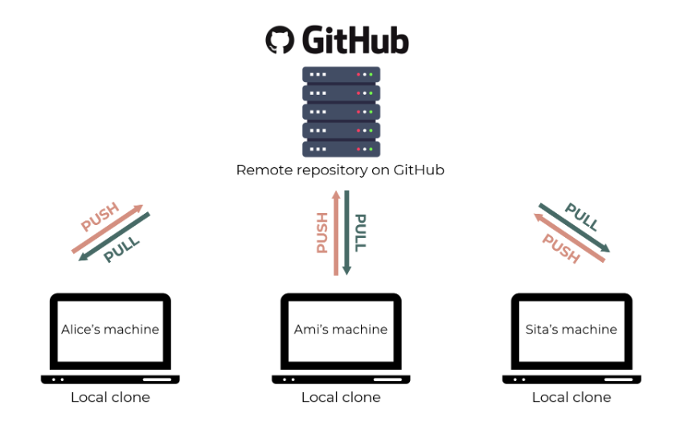
Git and github
Git
The software that allows us to do version control
Distributed Version Control System (DVCS)
Like “Track Changes” in docs but more rigorous, powerful, and scaled up to multiple files
Github
Hosting service for git projects (i.e. Dropbox for git)
Hosts remote repositories. You edit your work in your local repository and then send changes to the remote

Slide 3
Why use git(hub)?
Keeps your code more organized and documented for your own sanity and the sanity of your collaborators
Ensures work is reproducible
Imposes a certain discipline to your coding
Allows for taking risks when coding: if a new feature breaks your program, you can easily revert to a previous version that worked
Keeps multiple versions of everything

Slide 4
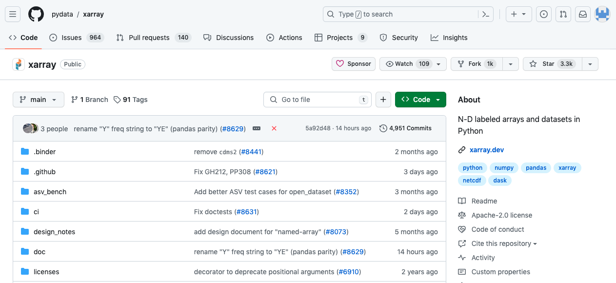
Github provides a platform for open source
Notes:
A pull request is a proposal to merge a set of changes from one branch into another. In a pull request, collaborators can review and discuss the proposed set of changes before they integrate the changes into the main codebase. Pull requests display the differences, or diffs, between the content in the source branch and the content in the target branch.

Slide 5
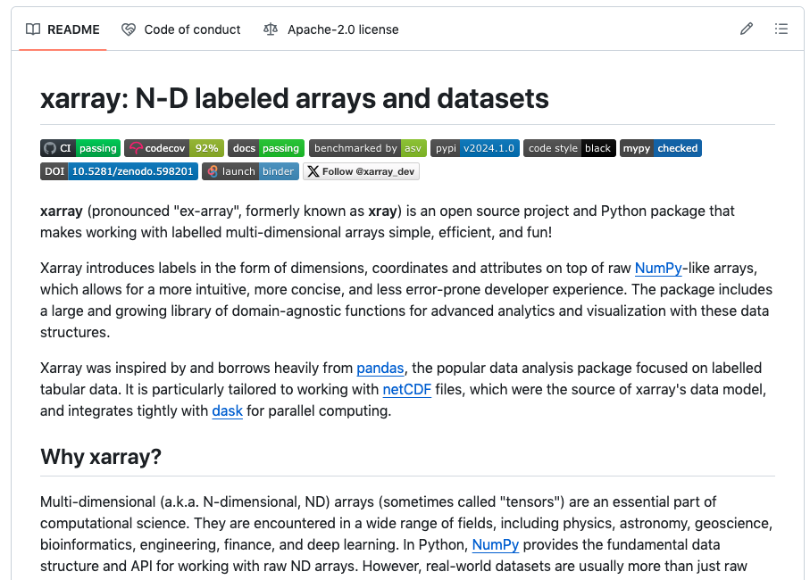
Github readme
Notes:
Badges: Continuous integration: passing means the code that has been tested passes
Codecov: percentage of code that has been tested. Less than 100% means there’s a chance for bugs in the untested code
Bencharked by airspeed velocity – tests how efficient the code is and how fast it should run
Binder: turn your github repository into a bunch of jupyter notebooks
It is the first file a person will see when they encounter your project, so it should be fairly brief but detailed.
It will make your project standout from a bunch of others. Also be sure your project is good too.
It will help you focus on what your project needs to deliver and how.
It will improve your writing skill

Slide 6
Setting up git environment
git config --global user.name ”dmw2166"
git config --global user.email ”dmw2166@Columbia.edu"
Use the same email as the one you signed up for on github
Only need to do this step once
This will be how any changes that you make are marked

Slide 7
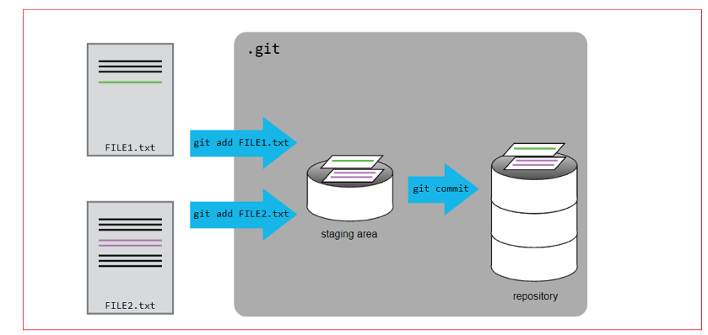
Basic git workflow
Local machine
Clone an existing repository or create your own. Recommended to create a blank one on Github.com and then clone it.
git init creates a repository of your current directory.
Make file changes locally
When ready, add the files to the staging area, then commit them to the repository (local). Include an informative message such as “plot distribution of precipitation” to whatever changes you make
When ready, push the commit to the remote (github.com) repository

Slide 8
Basic git commands (from the docs)
git init initializes a brand-new Git repository and begins tracking an existing directory. It adds a hidden subfolder within the existing directory that houses the internal data structure required for version control.
git clone creates a local copy of a project that already exists remotely. The clone includes all the project's files, history, and branches.
git add stages a change. Git tracks changes to a developer's codebase, but it's necessary to stage and take a snapshot of the changes to include them in the project's history.
git commit saves the snapshot to the project history and completes the change-tracking process. In short, a commit functions like taking a photo. Anything that's been staged with git add will become a part of the snapshot with git commit.
git status shows the status of changes as untracked, modified, or staged.
git branch shows the branches being worked on locally.
git merge merges lines of development together. This command is typically used to combine changes made on two distinct branches.
git pull updates the local line of development with updates from its remote counterpart. Developers use this command if a teammate has made commits to a branch on a remote, and they would like to reflect those changes in their local environment.
git push updates the remote repository with any commits made locally to a branch.

Slide 9
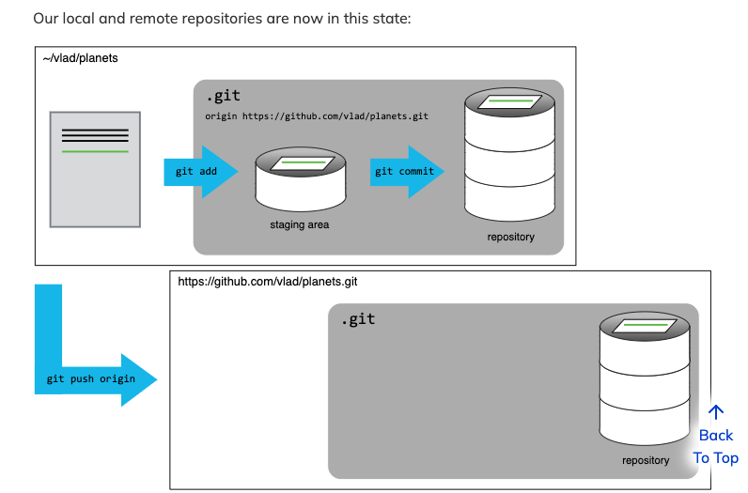
Local and remote workflow

Slide 10
Other git essentials
Branches in git are basically different versions of the code
git branch to view current branches in the repo
git checkout <branch name> to switch to an existing branch
git checkout –b <branch name> to create a new branch
If adding major features or major code developments, best practice is to create a new branch. You can merge branches later.

Slide 11
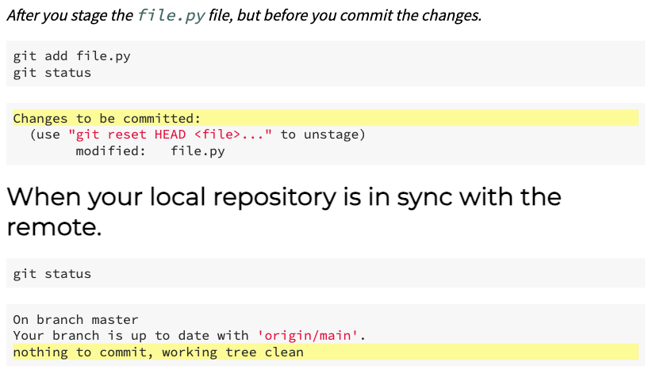
Other git essentials
git status
Tells you which files in your repository have been staged and committed. Also any files that are untracked

Slide 12
Other git essentials
git help <verb>
Get help on any of the commands
git diff
Print out a list of what has been edited but not staged
git diff --staged
Print out what is staged but not yet committed
git merge <branch>
Merge the specified branch’s history into the current one you have checked out

Slide 13
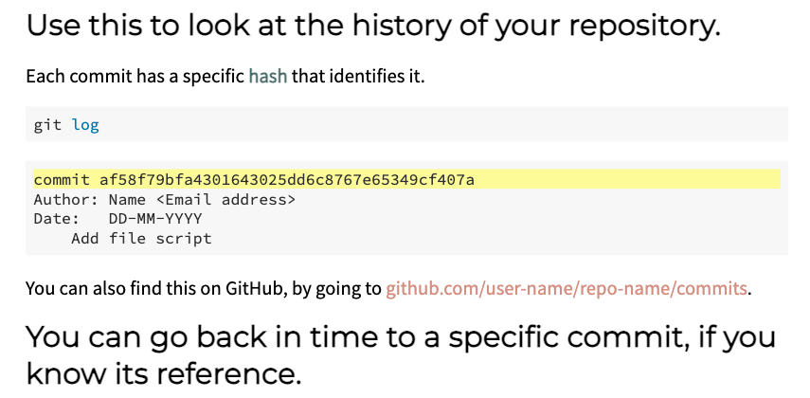
Other git essentials
git log

Slide 14
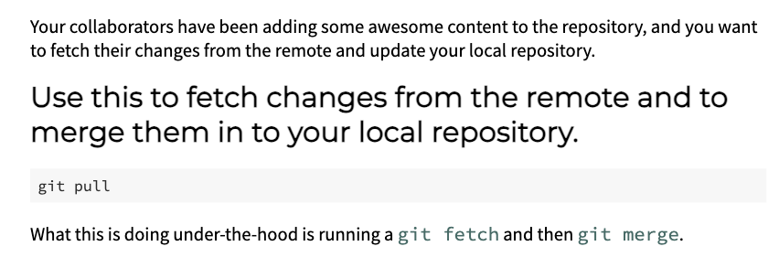
Other git essentials
git pull

Slide 15
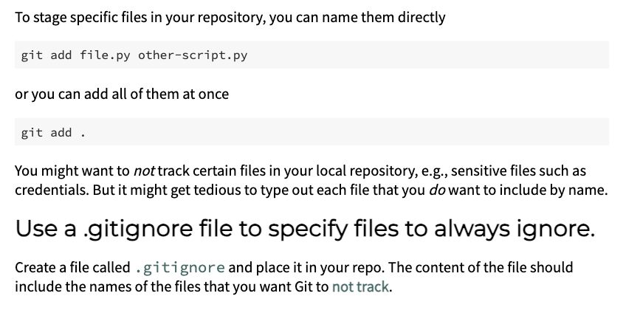
Adding and ignoring files

Slide 16
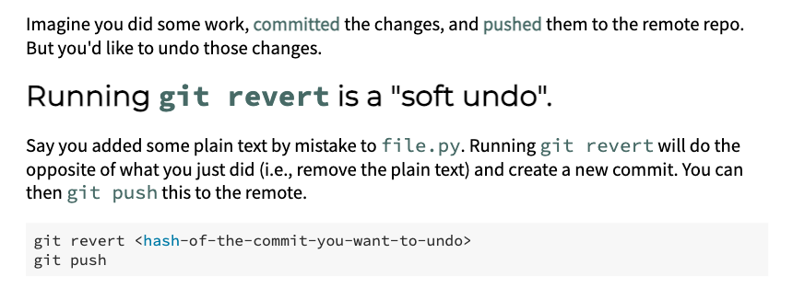
Undoing mistakes!

Slide 17
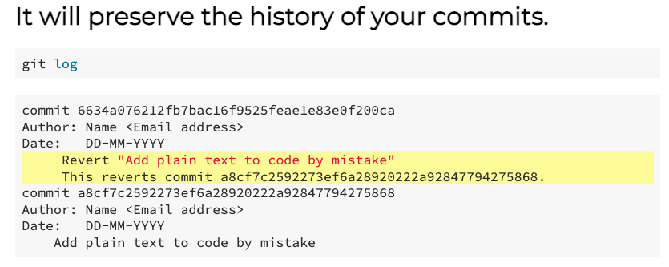
Undoing mistakes!

Slide 18
Lecture notes will be pushed to this repository
https://github.com/dmw2166/comp-res-climate-data-sci-online.git

Slide 19
Resources
https://docs.github.com/en/get-started/using-git/about-git#about-version-control-and-git
https://education.github.com/git-cheat-sheet-education.pdf
https://training.github.com/downloads/github-git-cheat-sheet/
https://swcarpentry.github.io/git-novice/
https://git-scm.com/docs

Slide 20
Try a few things
Create a new repository on GitHub, clone it, add a file, edit the file, diff the file, add/commit/push to the new repository, review status, review logs, revert the change, push again.
Markdown files example

Slide 21
Adding your upstream remote
git remote add origin git@github.com:dmw2166/example2026.git
git push
Chances are these command won’t work so far
Need to generate SSH keys
ssh-keygen -t rsa -b 4096 -C dmw2166@Columbia.edu
- Move the keys to your ~/.ssh/ hidden directory if they aren’t already there.
You should get some output to the screen. We can check the SSH keys worked
ls –al ~/.ssh
And then we need to give GitHub our public key
cat ~/.ssh/id_rsa_github.pub
Output looks something like this: ssh-rsa AAAAC3NzaC1lZDI1NTE5AAAAIDmRA3d51X0uu9wXek559gfn6UFNF69yZjChyBIU2qKI dmw2166@Columbia.edu
Go to github.com, login, and under settings look for “SSH and GPG keys”. Create a new SSH key and paste in the output above
Notes:
This command generates a new SSH key pair for secure authentication. Let me break down each part:
ssh-keygen - The program that creates SSH key pairs (a public key and a private key)
-t rsa - Specifies the type of key to create. RSA is a widely-supported encryption algorithm (though Ed25519 is now often preferred for new keys) (cryptographic key based on the RSA algorithm, which is one of the most widely used methods for secure data transmission and authentication)
-b 4096 - Sets the key length to 4096 bits. This makes the key more secure than the default 2048 bits, though it's slightly slower
-C "dmw2166@Columbia.edu" - Adds a comment/label to the key. This is typically your email address and helps you identify which key is which when you have multiple keys. It doesn't affect the key's function, just makes it easier to manag

Slide 22
Basic git workflow
Activiate your ssh keys
Eval $(ssh-agent)
Ssh-add /home/danielmw/.ssh/github_example2026
Clone the repository
git clone git@github.com:dmw2166/example2026.git
or “git init” in an existing directory on your local machine
Stage your files
git add .
Commit your changes
git commit -m "Add example code”
Connect your local repository to your remote one (on github.com)
git remote set-url origin git@github.com:username/repo.git
Assuming the remote and local already exist.
Push your changes
git push –u origin main
Notes:
git remote set-url origin git@github.com:username/repo.git ssh -T git@github.com

Slide 23
Markdown
https://www.markdownguide.org/basic-syntax/

Slide 24
Work on Assignment 1
Practice with git and github by creating a markdown file of a simple resumé
Connect your remote assignments repo (created in last week’s homework) to your directory on chopin and confirm you can push something

